Slide 1
SOLID principles

Slide 2
What is SOLID ?
Robert C. Martin compiled these principles in the 1990s.
Collection of guidelines for object oriented software design.
Five basic principle which help to create good software architecture.
Ways to move from tightly coupled code.
Help in making the object oriented application source code robust, scalable, extensible.
Essential when you have layered architecture and they are bound to change over the period of time.

Slide 3
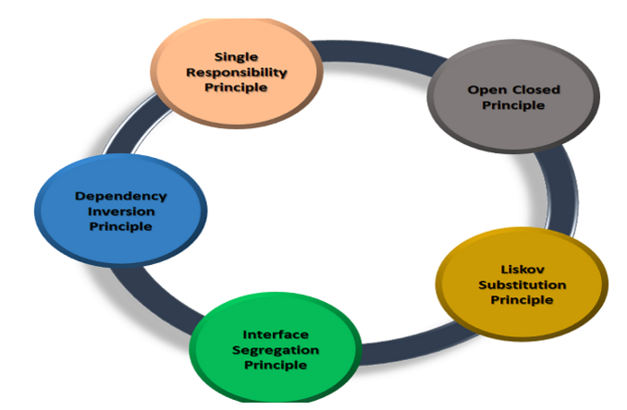
SOLID ….. Five Important Object Oriented Principles
Single responsibility principle (SRP)
Open-Closed principle (OCP)
Liskovs substitution principle (LSP)
Interface segregation principle (ISP)
Dependency inversion principle (DIP)

Slide 4
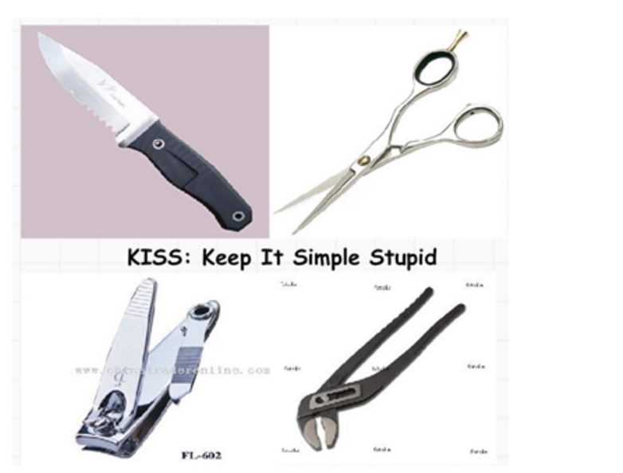
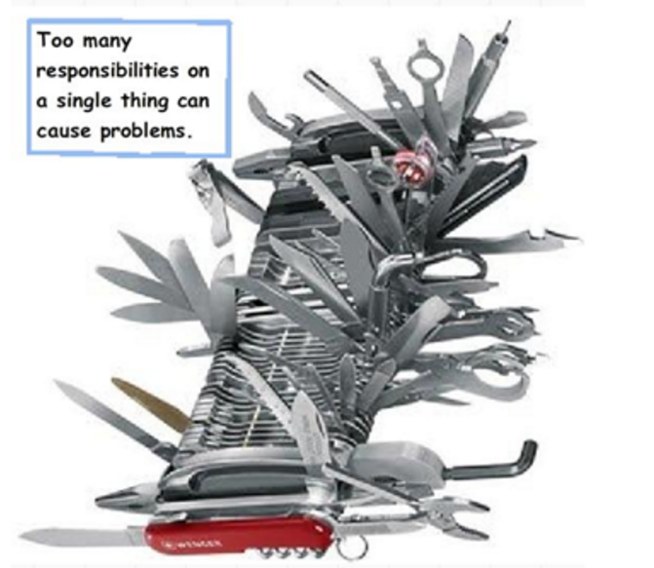
Single Responsibility Principle (SRP)
SRP : Every Class should have a single responsibility and the responsibility should be encapsulated by the class.
SRP Says “ Every Software Module should have only one responsibility to Change”.
In other words, every object should perform only one thing.

Slide 5
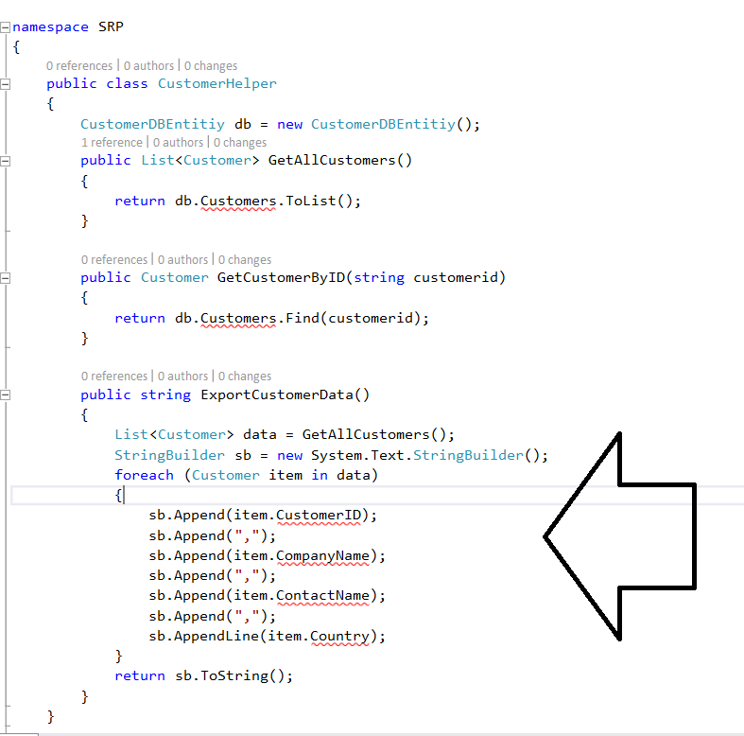
Sample Code Violates SRP

Slide 6
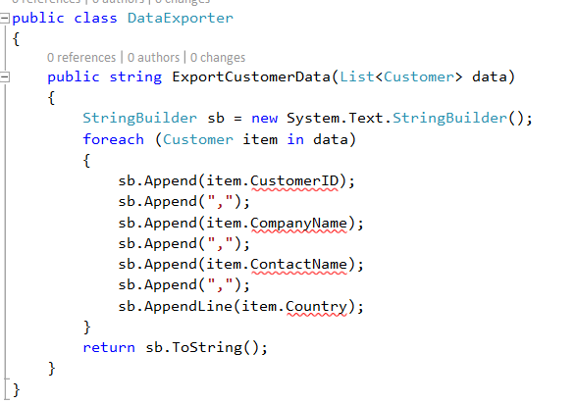
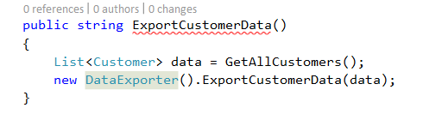
Refactor the code to Fit into SRP

Slide 7
Open Closed Principle (OCP)
In 1988 the open closed principle (OCP) is already mentioned by Bertrand Meyer :
Software should be open for extension, but closed for modification.
“software entities (classes, modules, functions, etc.) should be open for extension, but closed for modification”.
The best way to implement the open closed principle is to first start with implementing the Single Responsibility Principle.
You should design modules that never change. When requirements change, you extend the behaviour of such modules by adding new code, not by changing old code that already works.
Abstraction is the way to realize this principle. Derivatives from an abstraction are closed for modification because the abstraction is fixed but behaviour can be extended by creating new derivatives of the abstraction.

